Slide 1

Assessing Twitter’s Potential to Predict Lyme Disease Incidence Rates in the US
Harvard University Extension School
CSCI E-599a Data Science Capstone (Spring 2022)
Notes:
#A51C30
#B30838

Slide 2
Acknowledgments
Bruce Huang, Ph.D., Ed.D.
Bouchra Nasri, Ph.D.
Mamadou Yamar Thioub (Ph.D. Candidate)
Elda Laison, M.D.
Leonardo Neves, M.S. (Harvard Teaching Fellow)
Stephen Elston, Ph.D. (Harvard Instructor)
Jason Lin, ALM
Notes:
sample

Slide 3
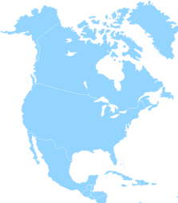



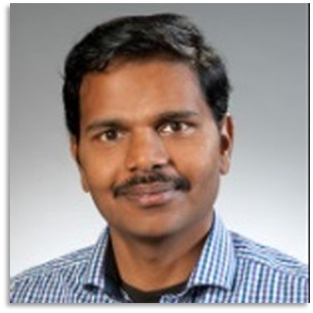
OUR TEAM
Austen Ng
Jiaxin (FIONA) Li
Raja Mahadevan
Srikanth Boligarla

Slide 4






Data Procurement
OUR AGENDA
Tweet Classification
EDA of Classified Tweets
Statistical Modeling
Conclusion & Future Direction

Slide 5

PURPOSE
Since lyme disease is the most common vector-borne disease in the US…
Need for better prediction of Lyme incidence rates
Benefits health community
Creates awareness FOR the populace

Slide 6


DATA procurement
Twitter
Universe
Search Query
Geo Location
Profile Location
Only 1%
#Lyme, #lymediease
Jan’10 to Dec’ 19
La California
Mars
217 M Active Users
40 K
1.3 M
Geopy
Training data
No
70 K
Yes
419 K
Lyme Tweets with Geo Information
Notes:
Some twitter facts …
217 M Active users
Only 1% of twitter users share geo information
Geo location is required for filtering tweets belonging to US counties.
Academic research privilege is a need for historical data collection.

Slide 7
CLASSIFICATION MODELS
PERFORMANCE METRICS
Accuracy
precision
Labeled the train dataset via regex
Trained the NLP models
Chose BERTweet
F1 score
recall
Notes:
Lyme is a name of the city in Connecticut. Around 480K tweets collected may have tweets not only related to
Lyme disease but also the city Lyme. We need a classification model to separate out the Lyme disease related .
Tweets.
Following Classification models were evaluated
Word2Vec using TF-IDF and Logistic regression for classification.
Word embedding using Gensim modeling and XgBoost for classification
BERT
BERTweet

Slide 8
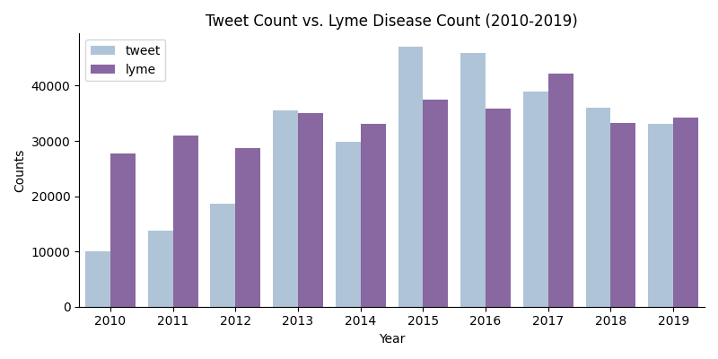
EXPLORATORY ANALYSIS

Slide 9
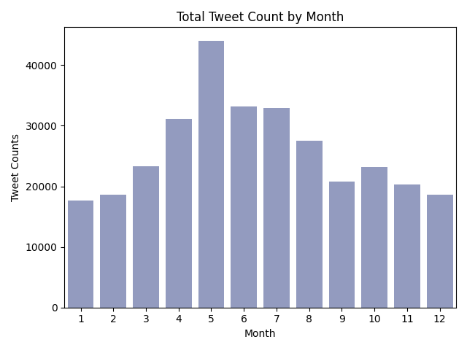
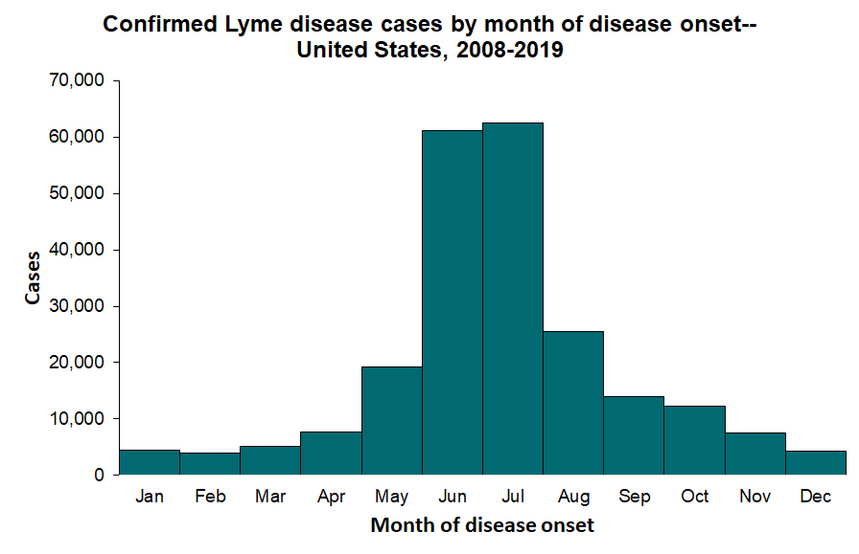
EXPLORATORY ANALYSIS

Slide 10
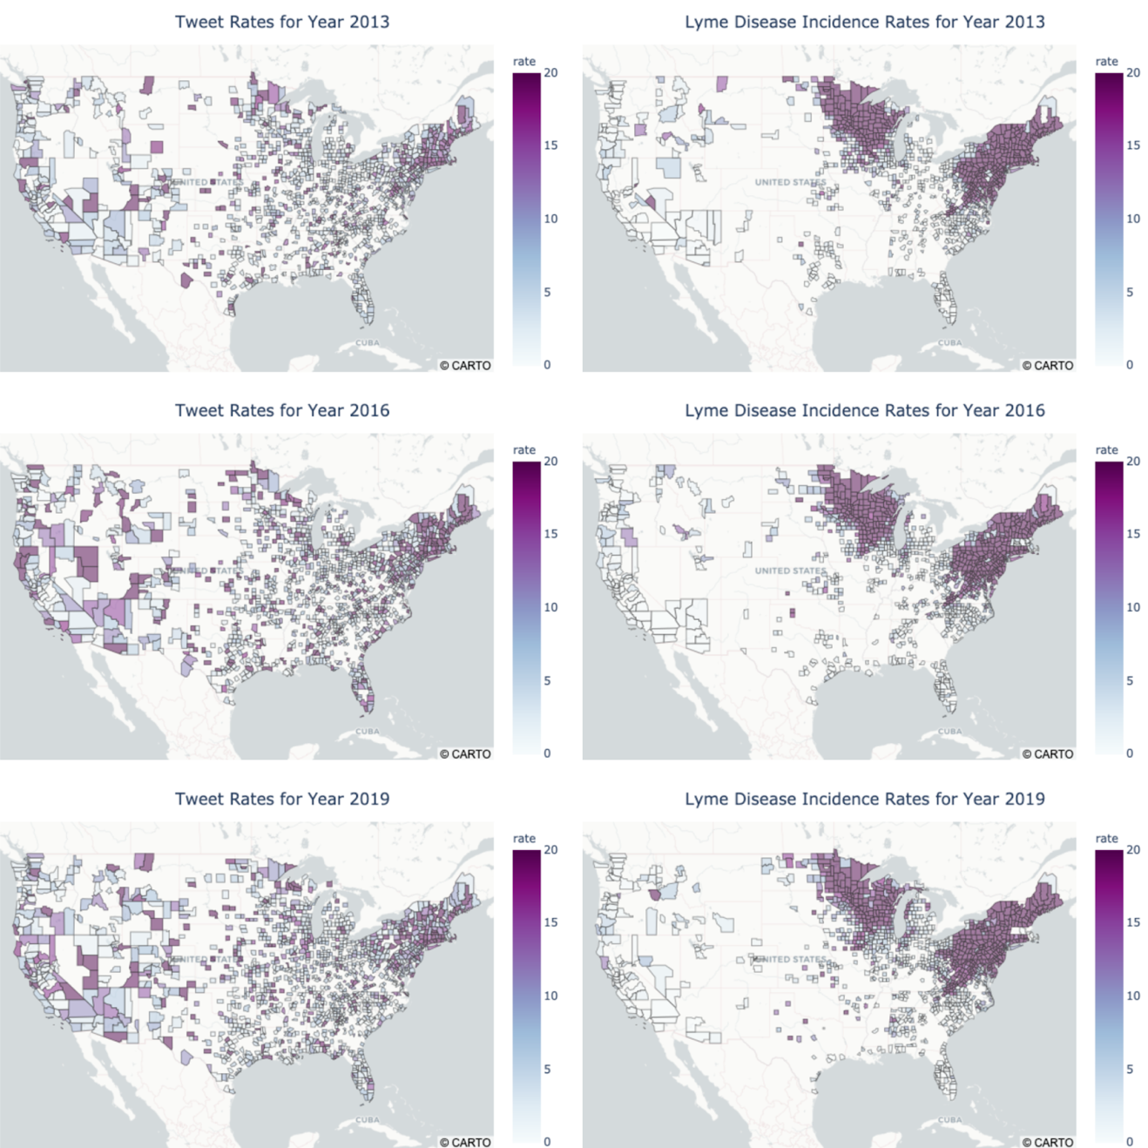
EXPLORATORY ANALYSIS
Consistent distribution patterns
Different correlations for each county

Slide 11
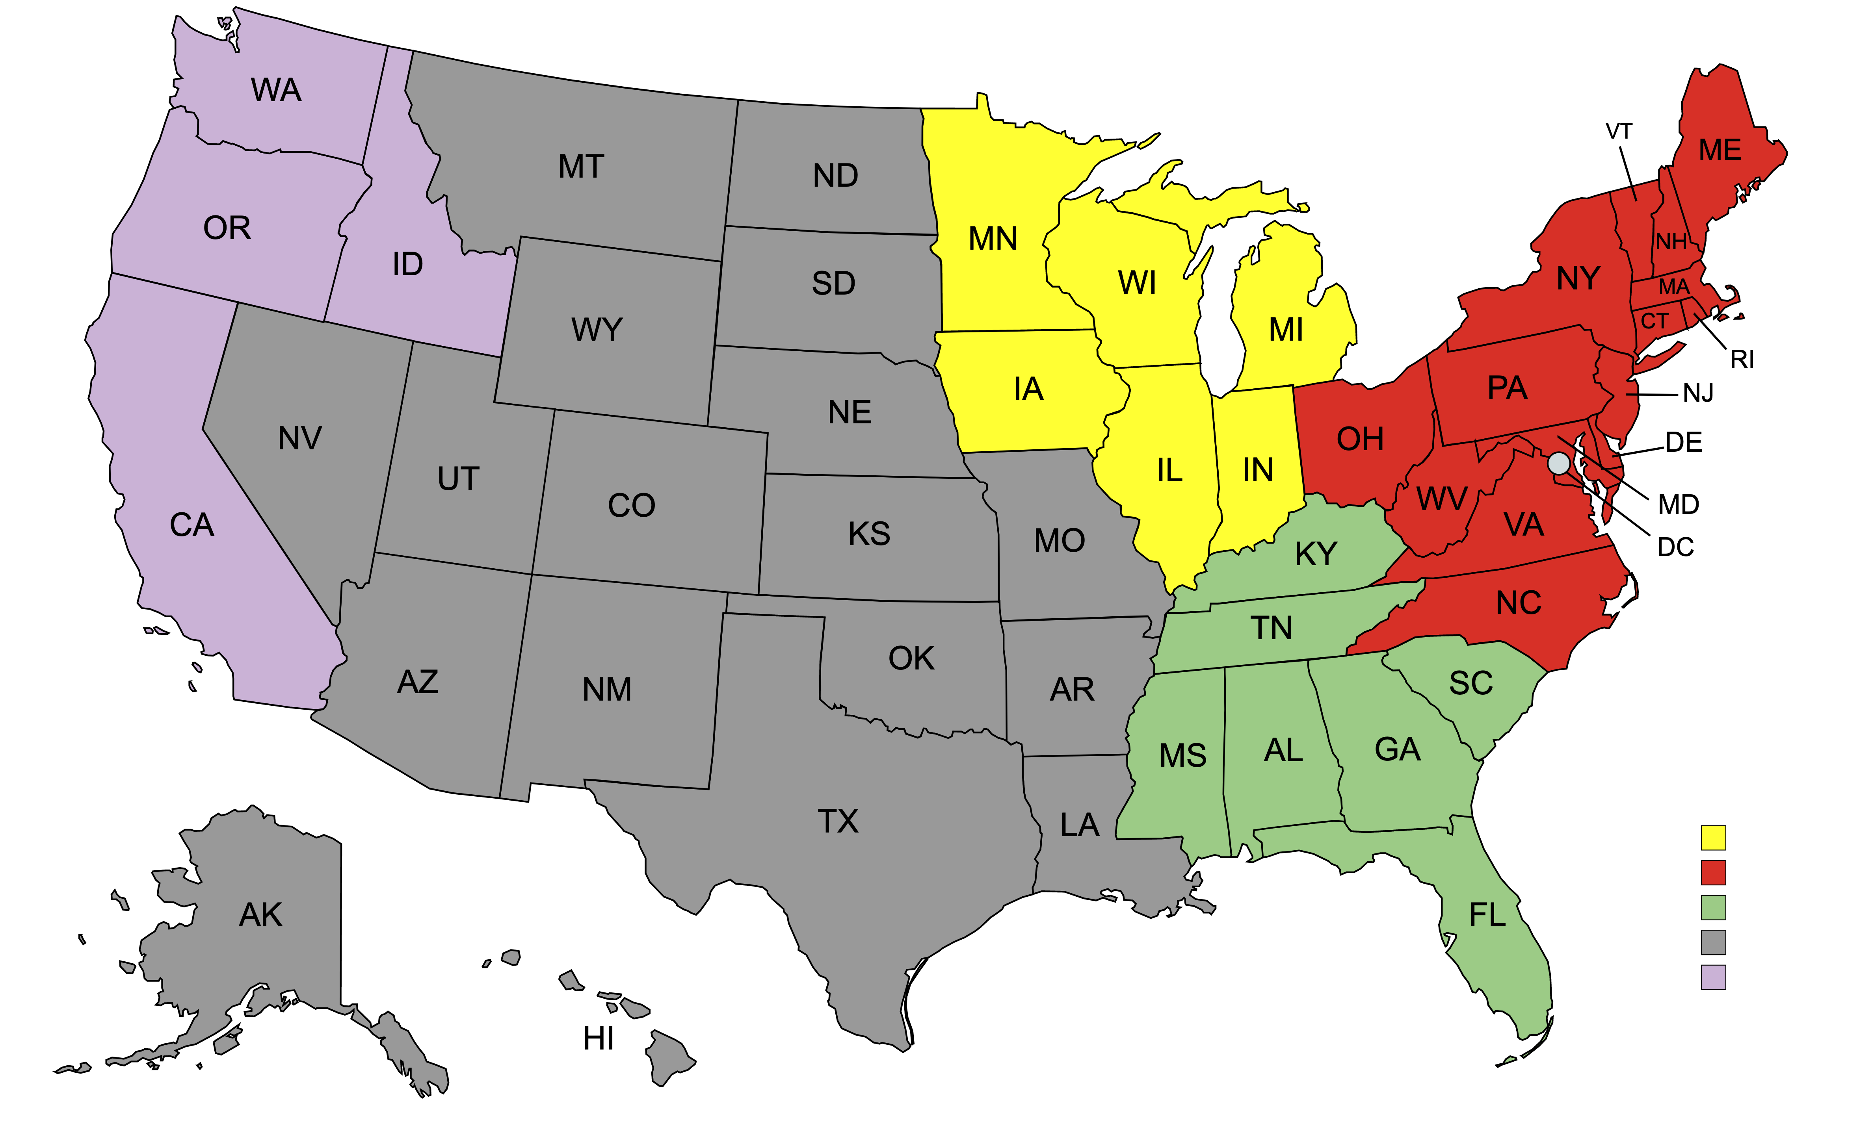
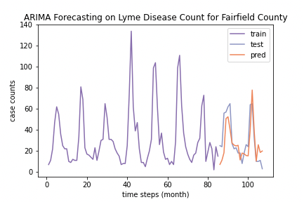
INCIDENCE RATE
PREDICTIVE MODELING
Time Series Forecasting (ARIMA)
Connecticut
Classification (KNN and Decision Tree)
Inconsistent Counties
County / State / Cluster level models
Features | All Counties | Inconsistent Counties
Tweet Rate | 0.94 | 0.66
Endemic Rate | 0.94 | 0.72
Selected accuracy scores of KNN models
Notes:
#2

Slide 12
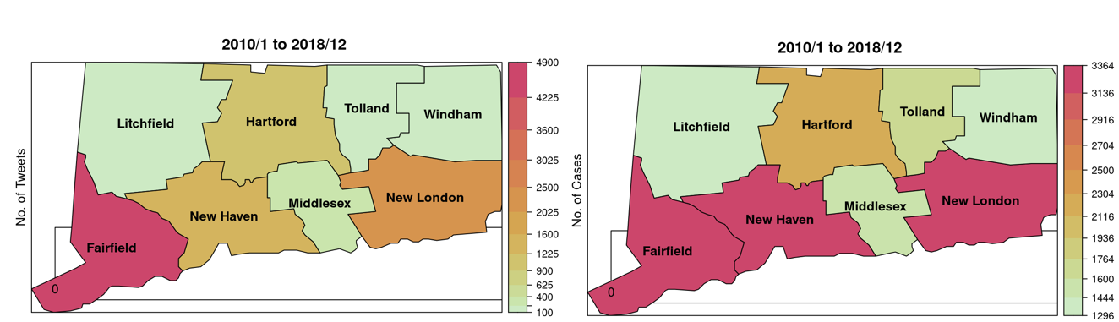
SPATIO-TEMPORAL ANALYSIS
Total tweets and case counts in Connecticut for 2010 to 2018
Notes:
#3

Slide 13
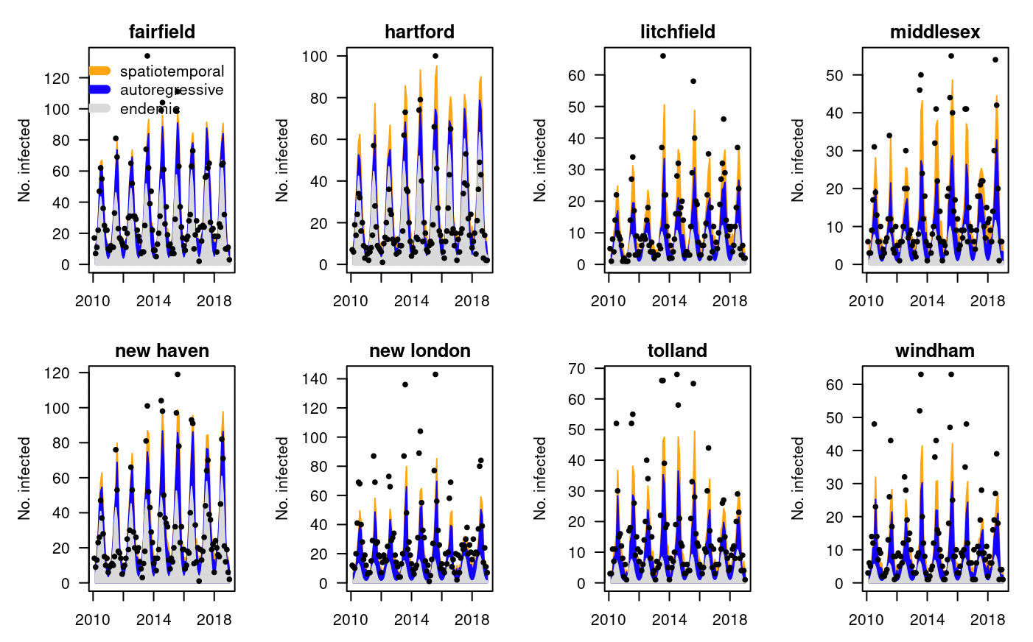
SPATIO-TEMPORAL ANALYSIS
CONT.
Lyme Cases For CT from 2010 to 2018
Model Metrics
Data Source | Logs | RPS | AIC
CDC | 3.55 | 6.03 | 6005.4
CDC + TWITTER | 4.78 | 6.49 | 8346.7
Notes:
#3

Slide 14

CONCLUSION
Good evidence from following
Data distribution
Incidence rate models
Tweets have limitations

Slide 15
FUTURE DIRECTION
Consider more general tweets about symptoms
1
Identify tweets that are related to actual disease case
2
Gather more data for monthly case counts
3

Slide 16
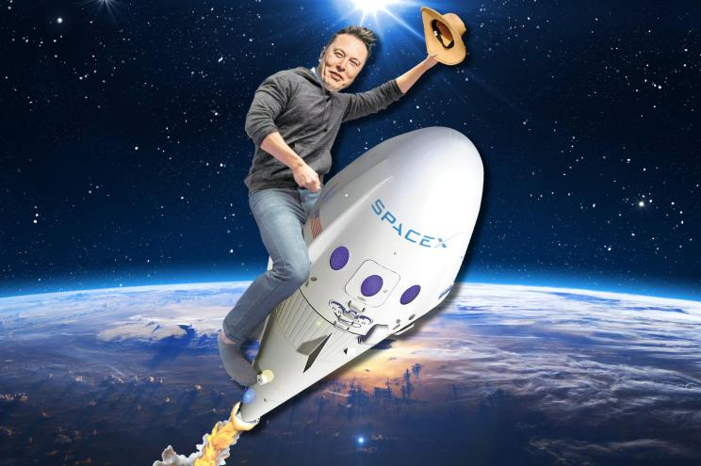
THANK YOU

Slide 17
REFERENCE
https://altarum.org/services/disease-surveillance - lens image
https://smart.servier.com/smart_image/north-america/ map image
https://slidemodel.com/templates/blue-marketing-plan-template-powerpoint/ - model
https://unsplash.com/photos/xG8IQMqMITM -agenda image
https://www.oomnitza.com/whitepaper/2022-tech-blind-spots-info/ purpose image
https://nypost.com/2020/09/30/shares-of-elon-musks-privately-held-spacex-soar-on-satellite-dreams/ Elon image

Slide 18
DATA PROCUREMENT
Twitter Universe
Twitter Universe
#Lyme, #lymediease
Jan’10 to Dec’ 21
#Lyme, #lymediease
Jan’10 to Dec’ 21
Mars
La California
Profile Location
Profile Location
1.3 M
1.3 M
Geo Location
Geo Location
40 K
Only 1%
40 K
217 M Active Users
Geopy
Geopy
Training data
Training data
70 K
70 K
Lyme Tweets with Geo Information
Lyme Tweets with Geo Information
480 K
480 K
Yes
Yes
440 K
440 K
Notes:
Some twitter facts …
217 M Active users
Only 1% of twitter users share geo information
Geo location is required for filtering tweets belonging to US counties.
Academic research privilege is a need for historical data collection.

Slide 19
FUTURE DIRECTIONS
Consider more general tweets about symptoms
Identify tweets that are related to actual disease case
Gather data from more states for monthly case counts

Slide 20
DATA procurement
Twitter Universe
Profile Location
1.3 M
Geo Location
40 K
Geopy
Training data
70 K
Lyme Tweets with Geo Information
440 K
Yes
480 K
Notes:
sample

Slide 21
CLASSIFICATION MODEL
F1 score
COMPARISON METRICS
Accuracy
precision
recall
Notes:
Lyme is a name of the city in Connecticut. Around 480K tweets collected may have tweets not only related to
Lyme disease but also the city Lyme. We need a classification model to separate out the Lyme disease related .
Tweets.
Following Classification models were evaluated
Word2Vec using TF-IDF and Logistic regression for classification.
Word embedding using Gensim modeling and XgBoost for classification
BERT
BERTweet

Slide 22
FUTURE DIRECTIONS
Consider more general tweets about symptoms
1
Identify tweets that are related to actual disease case
2
Gather more data for monthly case counts
3

